Slide 1
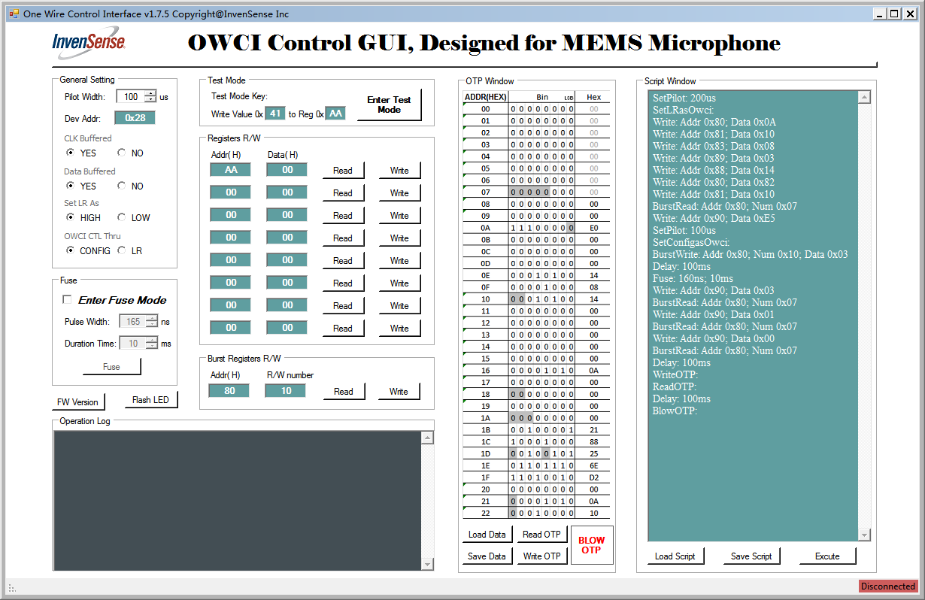
Overview of OWCI Software

Slide 2
Function Blocks of OWCI Software
General Setting
Hardware control, include pilot width and device address.
Test Mode
Enter Test Mode, supporting different DUTs.
Registers Read/Write
Single or burst registers read or write.
Fuse
Support eFuse.
OTP Window
OTP operation, bit by bit or byte by byte, load data from a .txt file and save data to a .txt file.
Script Window
Load script from a .txt file and execute, edit a script and execute or save to .txt file.
Operation log
Display all the operations include commands and return data
These operations are almost the same as last version software.

Slide 3
New Features
OTP window
Advantages:
1. Totally new designed tools for eMemery operation in md008, could be re-used in future project as well;
2. For each project, software will initialize OTP window based on a default config file, no need to rebuild a new GUI.
Script window
Advantages:
1. Script operation is a simple, flexible and efficient way for both PE and designers to do validation;
2. For each project, no need to rebuild a new GUI, just write new script and execute;
3. Script file is easy save and re-used between different sites.

Slide 4
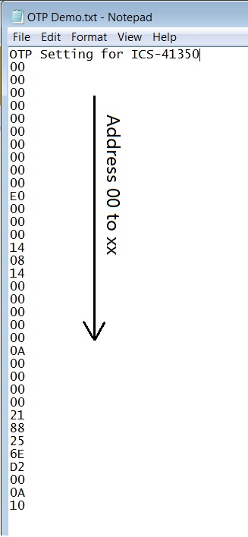
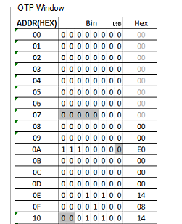
Blocks Review – OTP window
OTP setting file
Functions of OTP Window
Edit the window directly, supporting edit bit by bit or byte by byte, and write OTP or blow OTP;
Save window data to a .txt file as right format;
Load data form a .txt file as right format, and write OTP or blow OTP;
After load, also can edit the updated window, and then save to a file, write OTP or blow OTP;
Command line supporting, ext. writeotp.exe OTP Demo.txt blowotp.exe OTP Demo.txt (Note: xxxxotp.exe and OTP Demo.txt must be in same directory).
OTP setting name
OTP Window

Slide 5
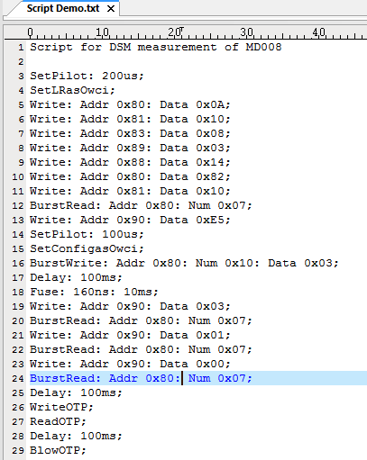
Blocks Review – Script window
Script file
Functions of Script Window
Edit a new script, and execute;
Edit a new script, and save to a .txt file as right format;
Load script form a .txt file as right format, and execute;
After load script, also can edit in the updated window, and then choose to save to a new file or execute.
Command line supporting, ext. execute.exe Script Demo.txt (Note: xxxxotp.exe and OTP Demo.txt must be in same directory).
Script name
Commands
execute from line3 to line 29
!!! Each command in single line

Slide 6
Description of Commands
Write: Addr 0x80; Data 0x10 //write value 0x10 to register 0x80
Read: Addr 0x80 //Read value of register 0x80
BurstWrite: Addr 0x80; Num 0x10; Data 0x03 //Burst write 0x03 to register 0x80-0x8A
BurstRead: Addr 0x80; Num 0x10 //Burst Read values of register 0x80-0x8A
SetPilot: 200us //Set pilot as 200us
Delay: 100ms //Delay 100ms
Fuse: 160ns; 10ms //Set fuse pulse as 160ns, fuse clock duration as 10ms, and fuse
WriteOTP: //Write OTP data to relative registers
ReadOTP: //Read OTP data
BlowOTP: //Blow OTP, take care of POWER
SetLrAsOwci: //Set LR pin on PCB as OWCI pin
SetConfigAsOwci: // Set CONFIG pin on PCB as OWCI pin

